Slide 1
BLDC Model
Modeling and Simulation
Presented By:2022_mc_58
Modeling and Simulation

Slide 2
Electromechanical Systems
BLDC Model
Modeling and Simulation
Presented By:2022_mc_58
In this modern and Evolved Era of science, Electric Motor is an important and crucial part of Our daily life .
Modern Ev’s ,Drones ,Washing machine ,Chillers ,Fans ,Incubators ,Lifts and much more uses Motors to operate
BLDC (Brushless Direct Current Motor ) is the more sophisticated version of Dc Motor Known for high speed and Accuracy .
It uses Dc voltage to operate but not directly except the modified one named pulsating DC.

Slide 3
Model the System
Presented By:2022_mc_58
BLDC Model
Electromechanical Systems
So based on the statistics we want to develop a Mathematical system that can mimic and ideally poses the values on the given parameters
In this modern and Evolved Era of science, Electric Motor is an important and crucial part of Our daily life .
Modern Ev’s ,Drones ,Washing machine ,Chillers ,Fans ,Incubators ,Lifts and much more uses Motors to operate
BLDC (Brushless Direct Current Motor ) is the more sophisticated version of Dc Motor Known for high speed and Accuracy .
It uses Dc voltage to operate but not directly except the modified one named pulsating DC.
Break the system to its sub-Systems
Supply
PWM
ESC
BLDC
3
BLDC Model
Modeling and Simulation
Presented By:2022_mc_58
Modeling and Simulation
Modeling and Simulation

Slide 4


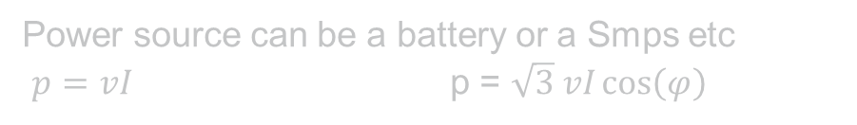
Electromechanical Systems
In this modern and Evolved Era of science, Electric Motor is an important and crucial part of Our daily life .
Modern Ev’s ,Drones ,Washing machine ,Chillers ,Fans ,Incubators ,Lifts and much more uses Motors to operate
BLDC (Brushless Direct Current Motor ) is the more sophisticated version of Dc Motor Known for high speed and Accuracy .
It uses Dc voltage to operate but not directly except the modified one named pulsating DC.
Power source can be a battery or a Smps etc
$p=vI$ p = $\sqrt{3} vI\cos\left(φ\right)$
Power Source
Model the System
So based on the statistics we want to develop a Mathematical system that can mimic and ideally poses the values on the given parameters
Break the system to its sub-Systems
Supply
PWM
ESC
BLDC

Slide 5
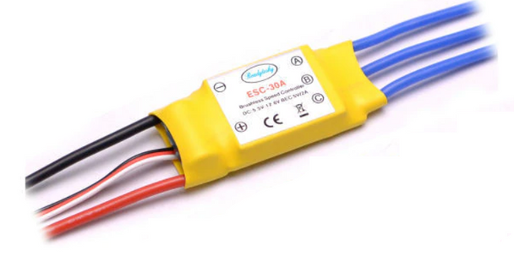


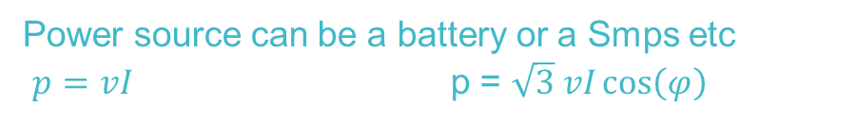
Model the System
ESC(Electronic Speed Controller)
Esc Takes Input as Power DC and PWM signal and converts it into The pulsated Dc Voltage
Power Source
Break the system to its sub-Systems
$$P=\sqrt{3t}\cos\left(θ\right)v^{2}\left(z\right)$$
Power source can be a battery or a Smps etc
$p=vI$ p = $\sqrt{3} vI\cos\left(φ\right)$
Supply
PWM
ESC
BLDC
$$P=Iv+Kv$$
So based on the statistics we want to develop a Mathematical system that can mimic and ideally poses the values on the given parameters

Slide 6
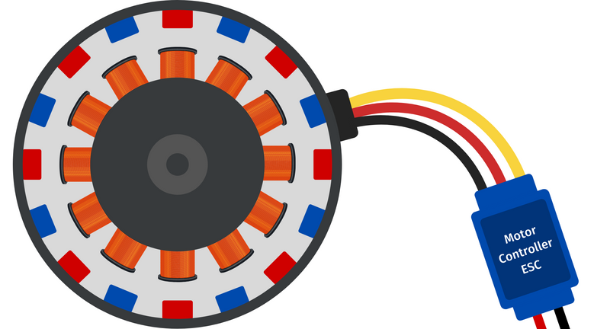


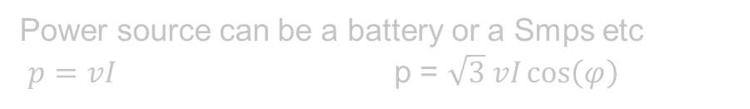
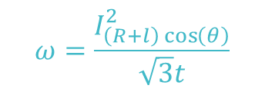
$$ω=\frac{I_{\left(R+l\right)\cos\left(θ\right)}^{2}}{\sqrt{3}t}$$
The motor is composed of Many parameter of which include the following
Power Source
Power source can be a battery or a Smps etc
$p=vI$ p = $\sqrt{3} vI\cos\left(φ\right)$
MOTOR
ESC(Electronic Speed Controller)
Esc Takes Input as Power DC and PWM signal and converts it into The pulsated Dc Voltage
$$P=Iv+Kv$$
$$P=\sqrt{3t}\cos\left(θ\right)v^{2}\left(z\right)$$

Slide 7
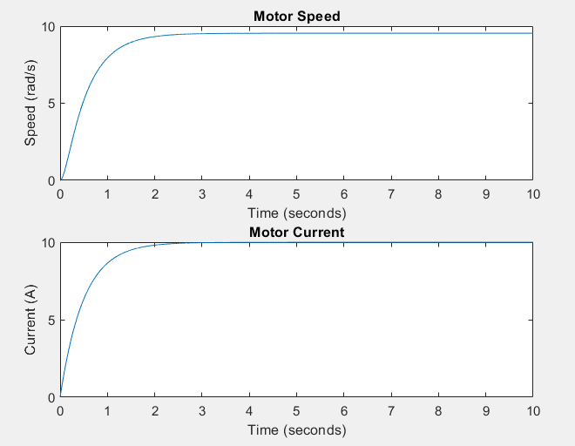



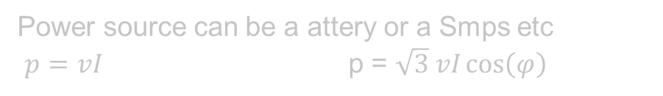
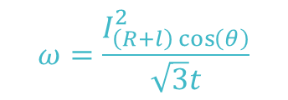
Power source can be a attery or a Smps etc
$p=vI$ p = $\sqrt{3} vI\cos\left(φ\right)$
Output on MATLAB Software
ESC(Electronic Speed Controller)
MOTOR
Esc Takes Input as Power DC and PWM signal and converts it into The pulsated Dc Voltage
The motor is composed of Many parameter of which include the following
$$ω=\frac{I_{\left(R+l\right)\cos\left(θ\right)}^{2}}{\sqrt{3}t}$$
7
Supply
$$P=\sqrt{3t}\cos\left(θ\right)v^{2}\left(z\right)$$
$$P=Iv+Kv$$

Slide 8
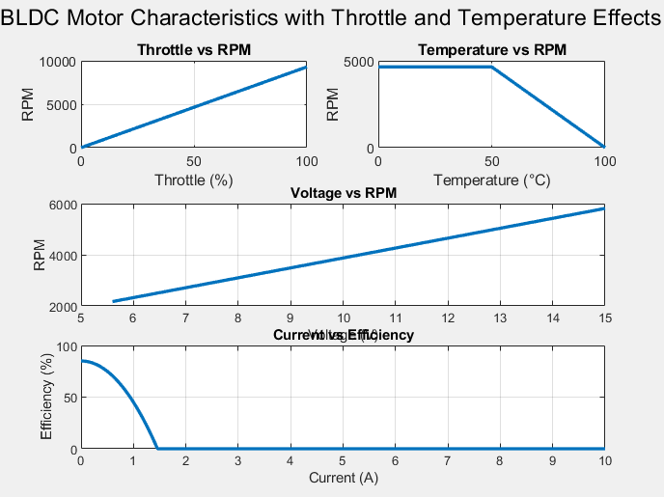
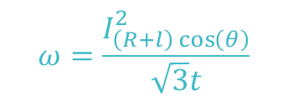
MOTOR
Output on MATLAB Software
The motor is composed of Many parameter of which include the following
$$ω=\frac{I_{\left(R+l\right)\cos\left(θ\right)}^{2}}{\sqrt{3}t}$$

Slide 10
Thank You

